Slide 1

LAND MANAGEMENT – SEMINAR
SITE APPRAISAL OVERVIEW
PRESENTED BY:
JIGNESH AMADAVADI
ABDUL AHAD
ROLLAND ATTI-AMETSIKOR

Slide 2
INDEX
Introduction to the site
Methodology to the site Appraisal
Appraisal finding and Recommendations

Slide 3
INTRODUCTION TO THE SITE
Data collection: Utilizing GIS mapping and local data sources for thorough analysis.
Current Use: Currently underutilized, potential of redevelopment proposals.
Purpose of Appraisal: To assess the potential for mixed-use development- for Urban development

Slide 4
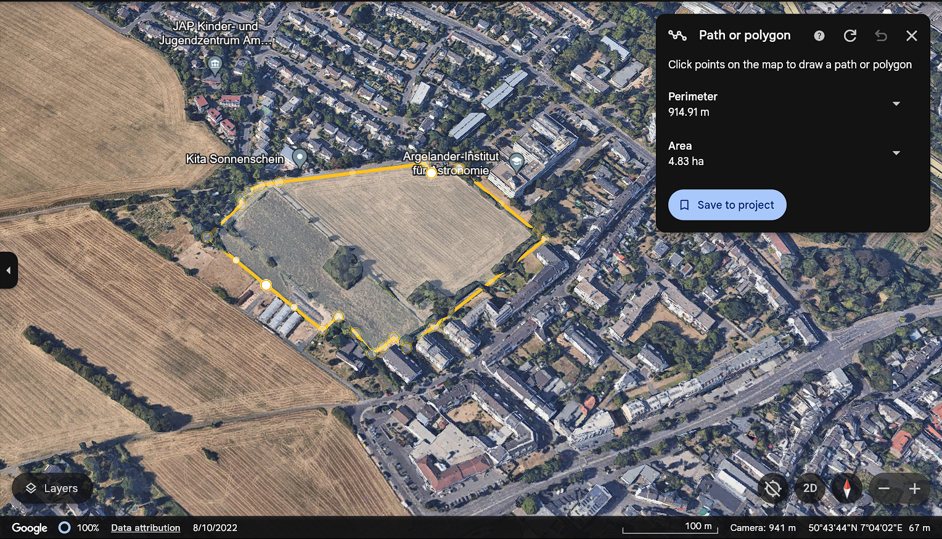
INTRODUCTION TO THE SITE

Slide 5
METHODOLOGY OF SITE APPRAISAL
Data collection: Utilizing GIS mapping and site visit for access local data.
Tools Used: We have employed a comprehensive range of tools, including Google Earth to ensure topography is flat.
Key Features Examined:
Transportation Accessibility: BUS, TRAIN station
Proximity to services: Hospitals, supermarkets, schools, Adequate Recreational Areas like restaurants, cafes, Pub, Gymnasium, SportsCenter, Government Buildings Religious Building
Environmental and zoning constraints: Messdorf Fields, Schools & Uni-bonn Institute, Residential Area,

Slide 6
APPRAISAL FINDINGS AND RECOMMENDATIONS:
Strength: This location is not just ideal for urban development, but it also boosts excellent transport links.
The Bahnhof just 2.5 km away via the Hermann –Wandersleb ring road, and the nearest hospital is Gemeinschafts Ranken Haus Bonn which is within 2.1 km and accessibility is a key advantage.
At every 10 minutes a bus is available from the Bus stop within 300 meters of Immenburk Park, Auf Dum Hugel and Bonn Erich-Hoffmann-Str.
The Tram connection is the Bonn-Endenich Nord connection within 1000 meters of the given site, further enhancing the area's connectivity.

Slide 7
APPRAISAL FINDINGS AND RECOMMENDATIONS:
Challenges: Zoning limitations School-University Institute of Astronomie & Max Plank Radioastronomie and studentenwohnhiem in the Northeastern site, Kindergarten, environmental considerations messdorf Fields Nature Conserve, Immenburk Private Farms like honey at the corner of Babette-Koch weg street crossing between the site connecting Am propsthof street to seeing street - Green Area, Park--Messdorf Fields spread until job center, only green areas access for Endenich /lessenich, Auf dum Hugel shows in pictures.

Slide 8
APPRAISAL FINDINGS AND RECOMMENDATIONS:
Opportunities (Proximity of site): The potential for mixed-use development is immense, offering a variety of public amenities. For example, an Aldi, Netto, Rewe, Bio market, cafes, and Restaurants, Theatre Harmonie, Pub Findlers, Escape Game Fun center, Gymnasium Supermarket to a Job Arbeite office, a Kindergarten to a Studentenwerk Wonheim, and even a sports center in the Lessnich area behind the Job Center of Bonn neighborhood, the possibilities are endless. This is a chance to create a vibrant, autonomous community.

